Slide 2
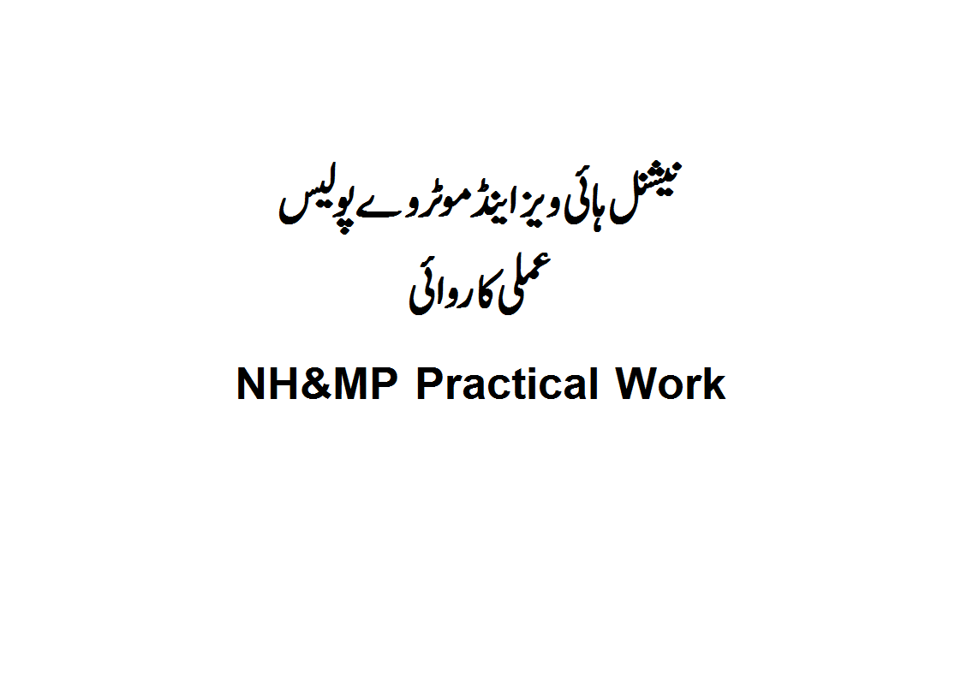
NH&MP Training College

Slide 3
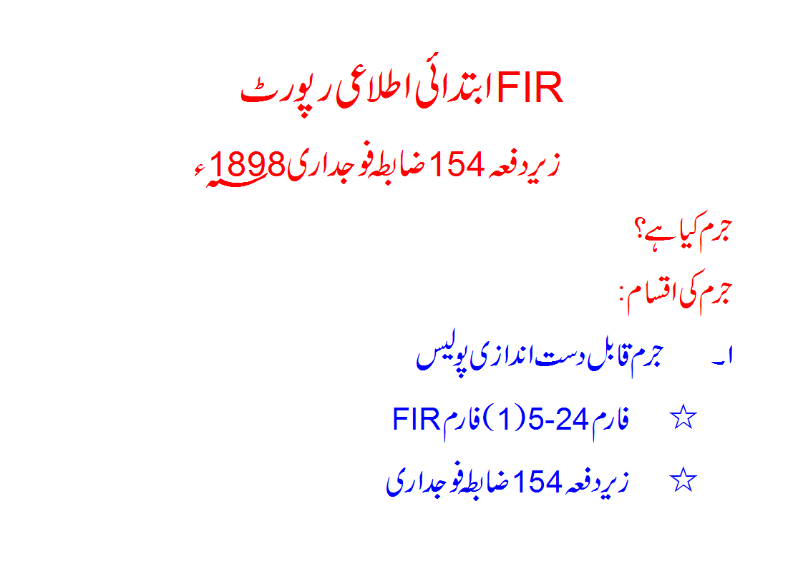
SECTION,4 crpc

Slide 4
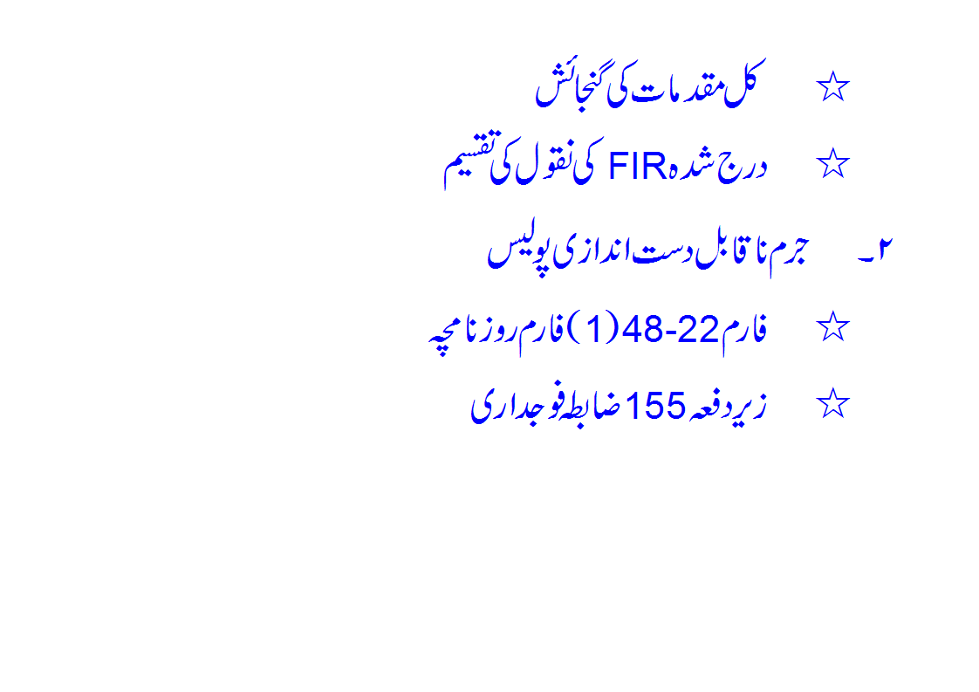

Slide 5
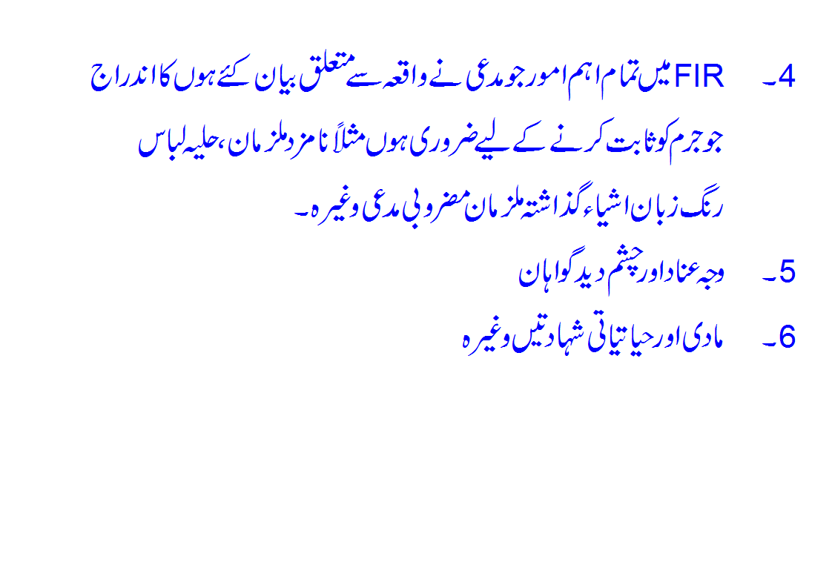

Slide 6
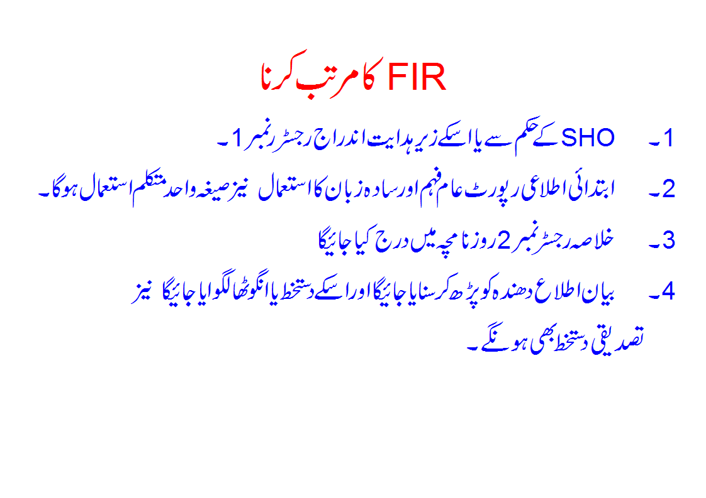

Slide 7
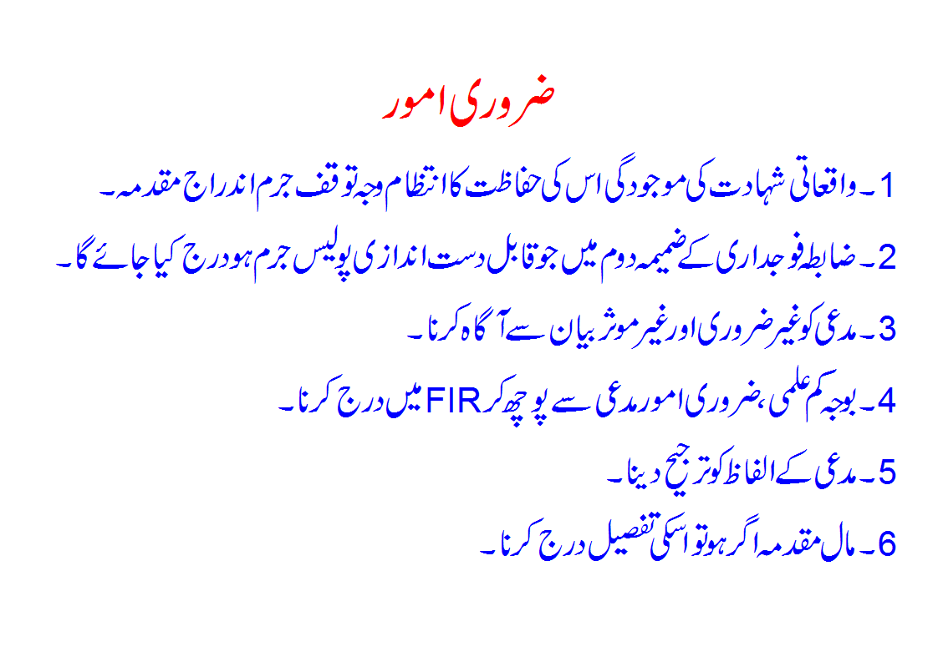

Slide 8
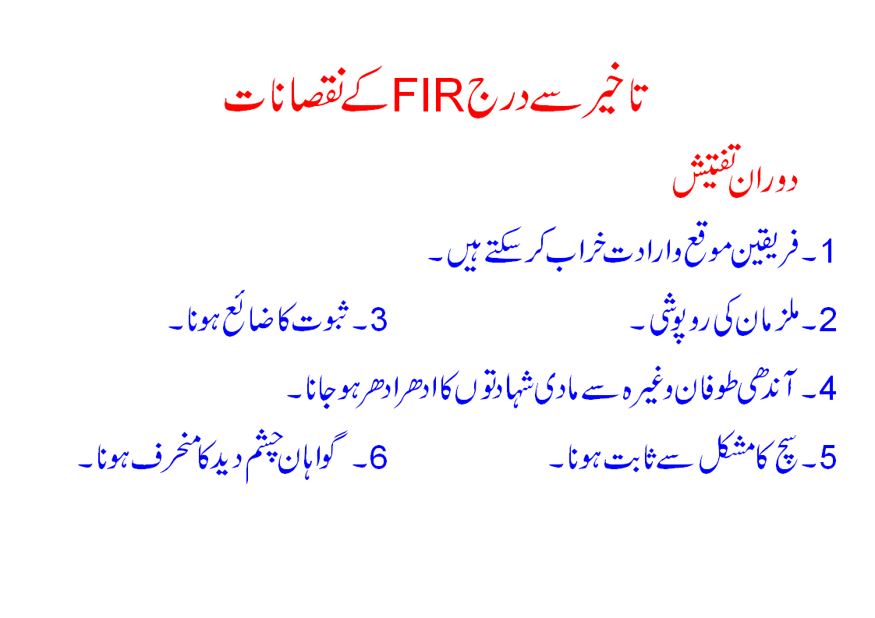

Slide 9
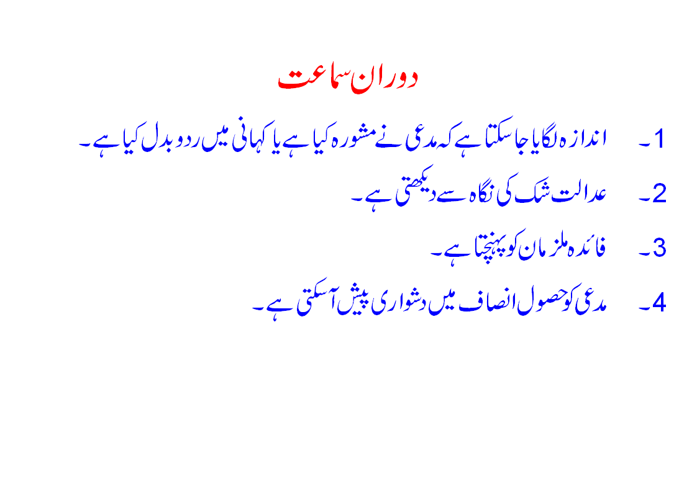

Slide 10
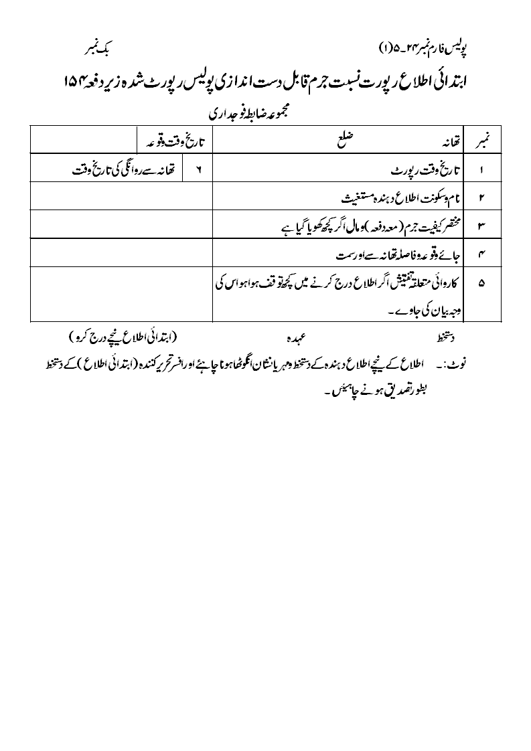
مقدمہ نمبر

Slide 11
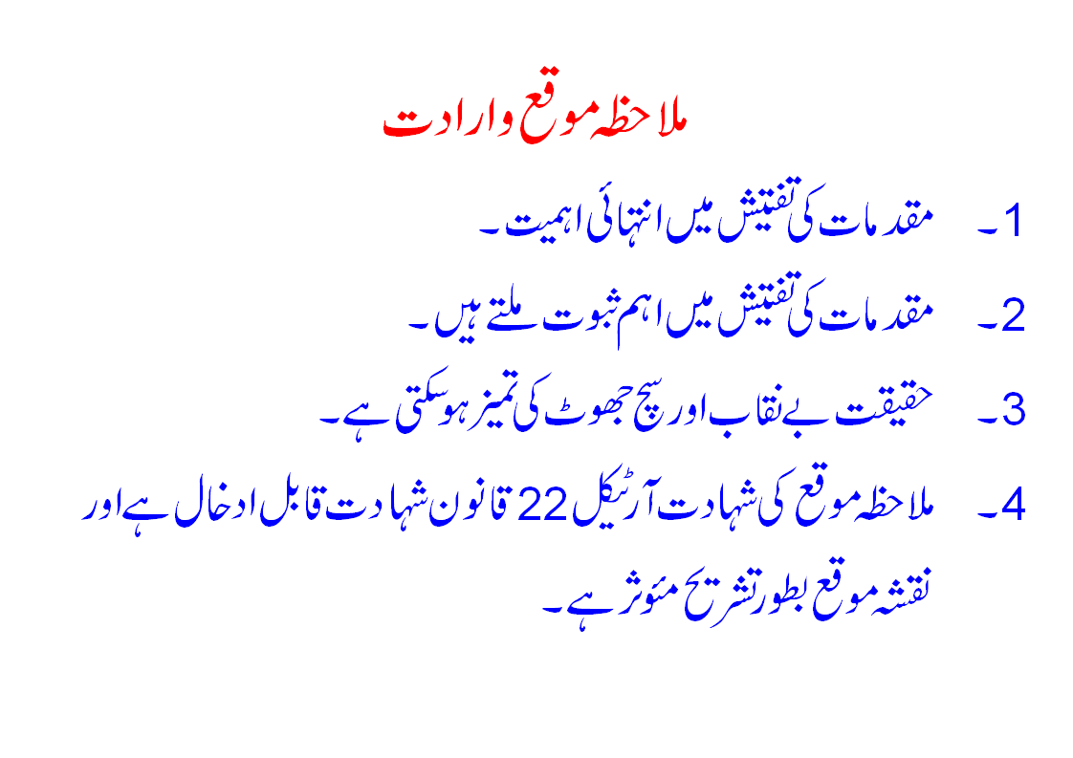
(SECTION, 157 crpc)

Slide 12
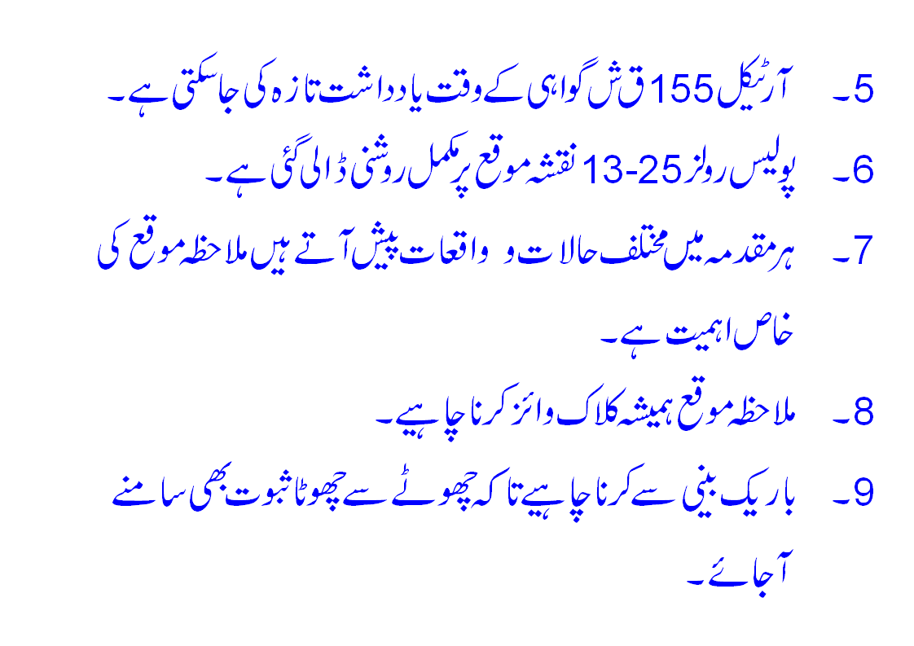

Slide 13
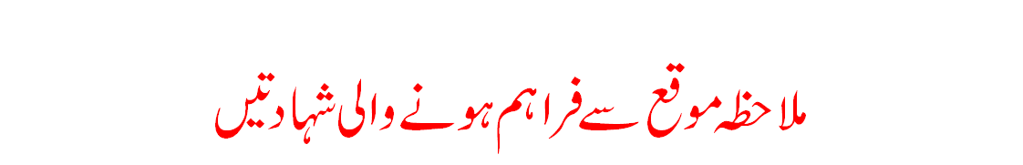
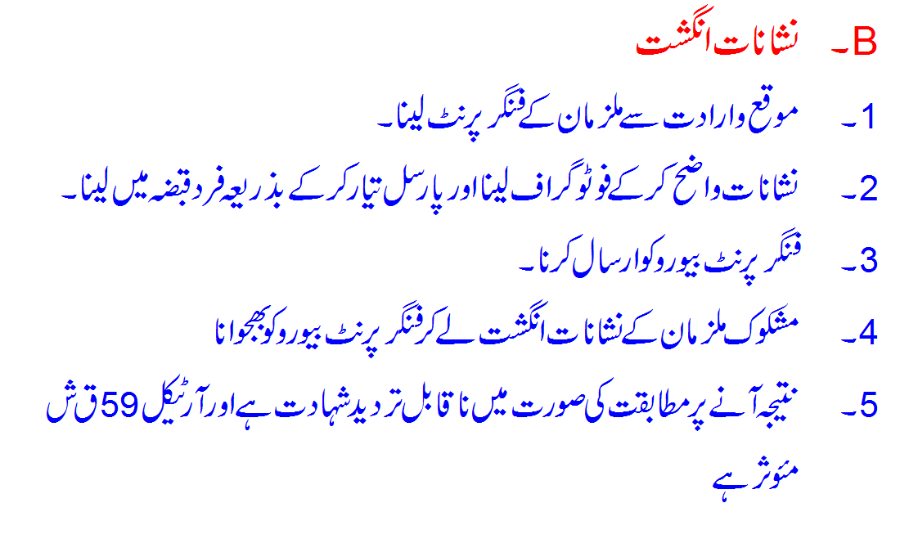

Slide 14
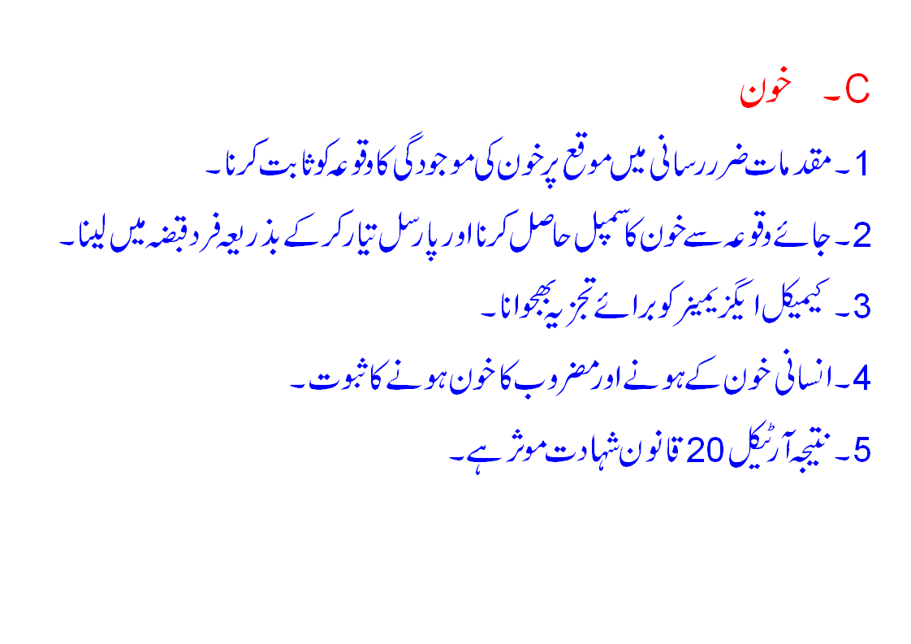

Slide 15
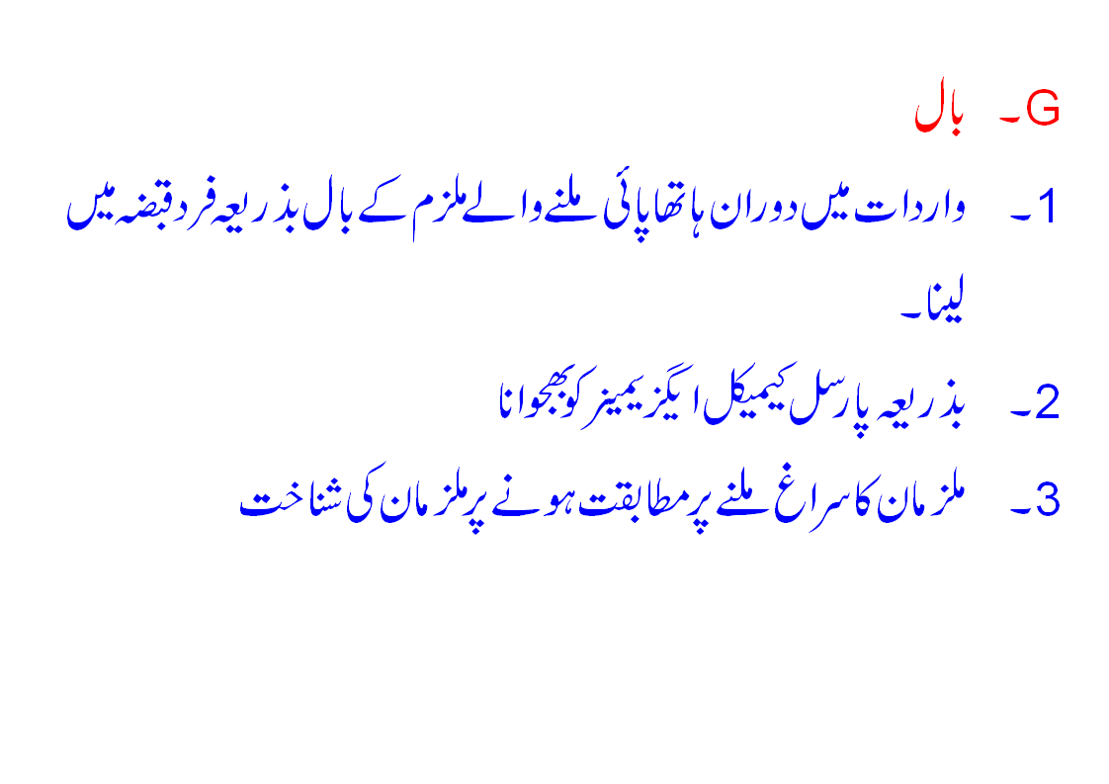

Slide 16
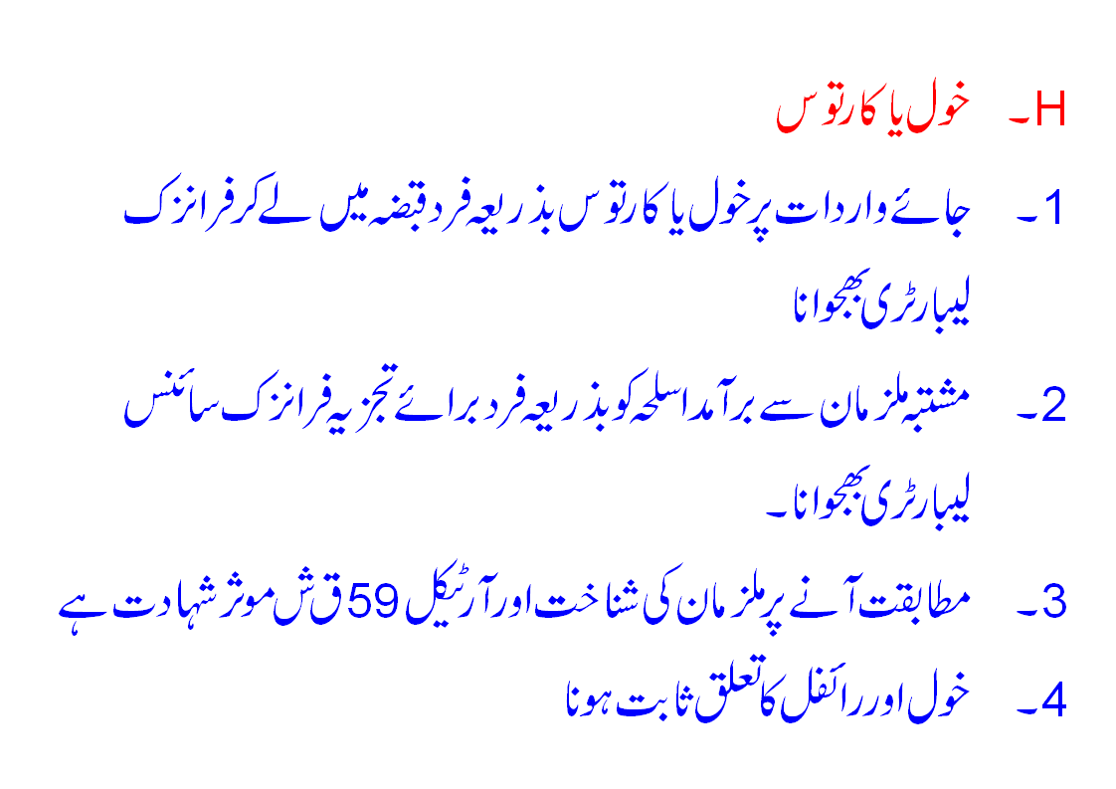

Slide 17
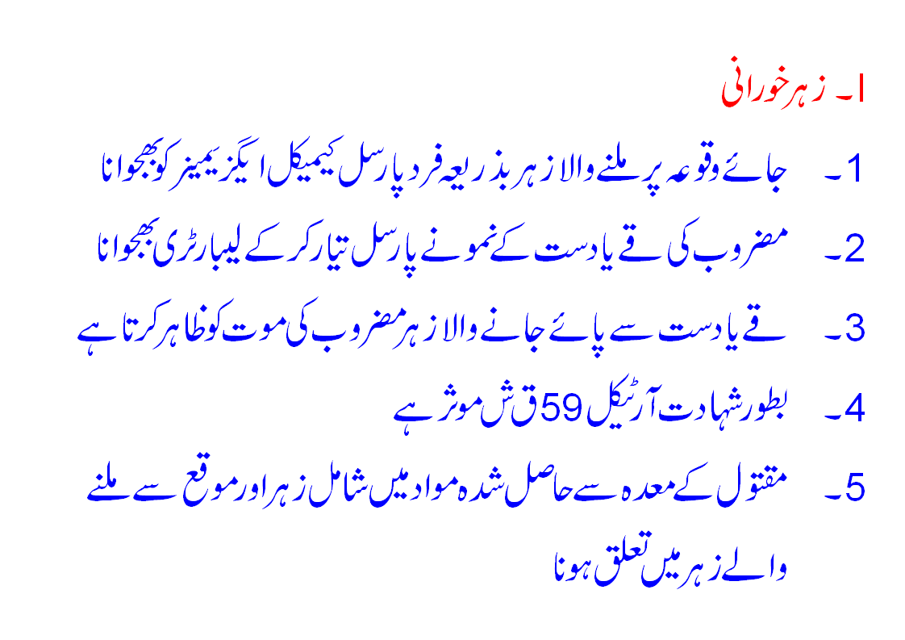

Slide 18
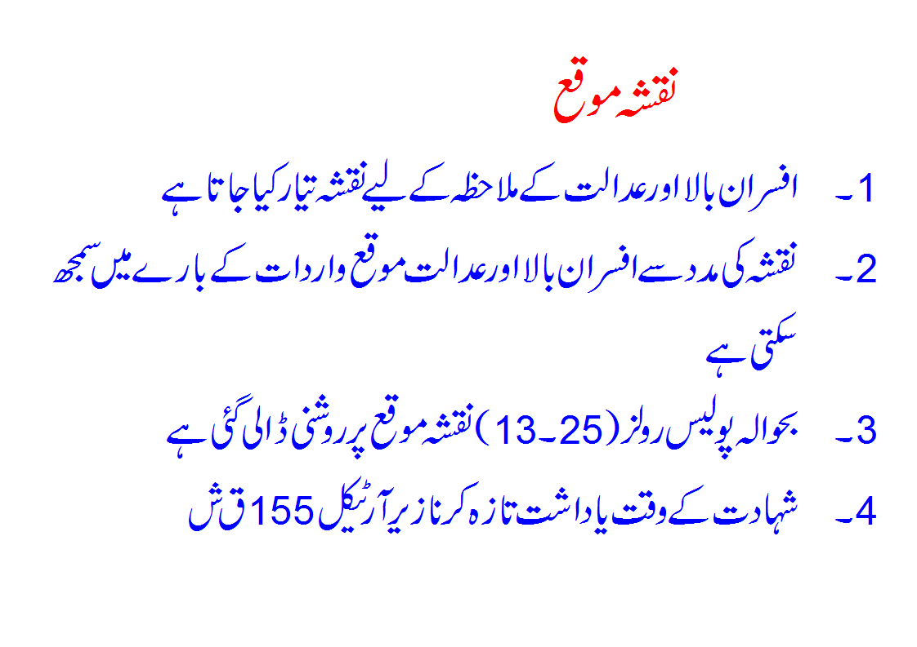

Slide 19
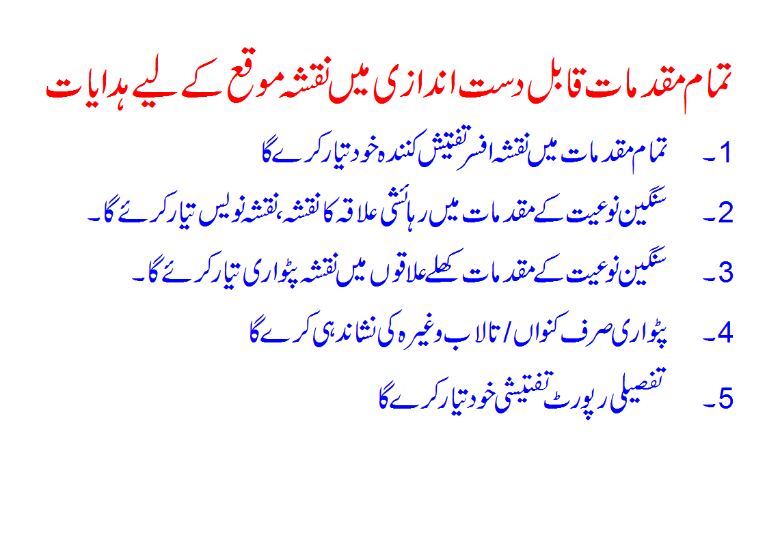

Slide 20
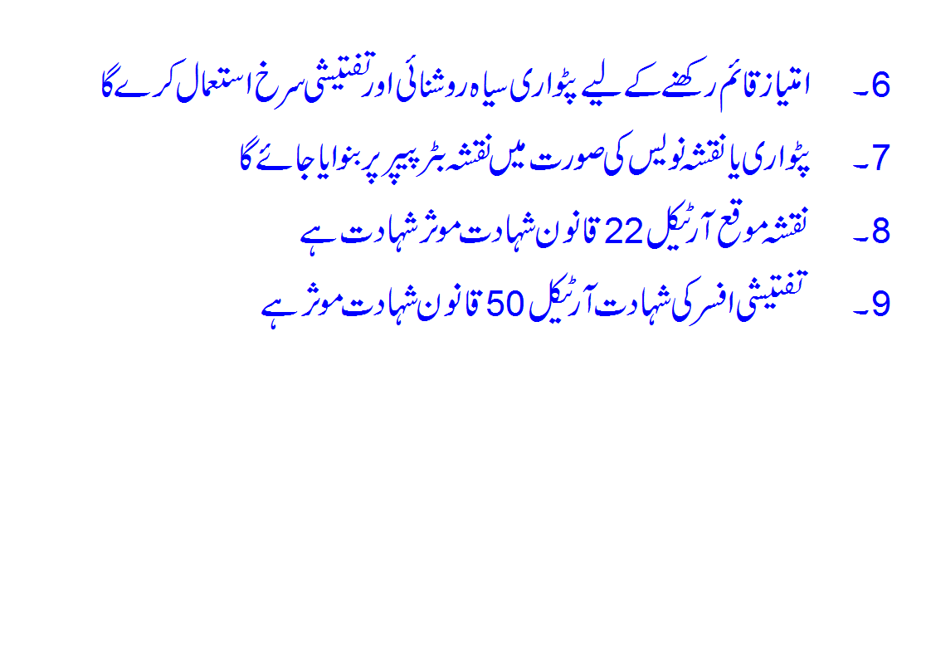

Slide 21
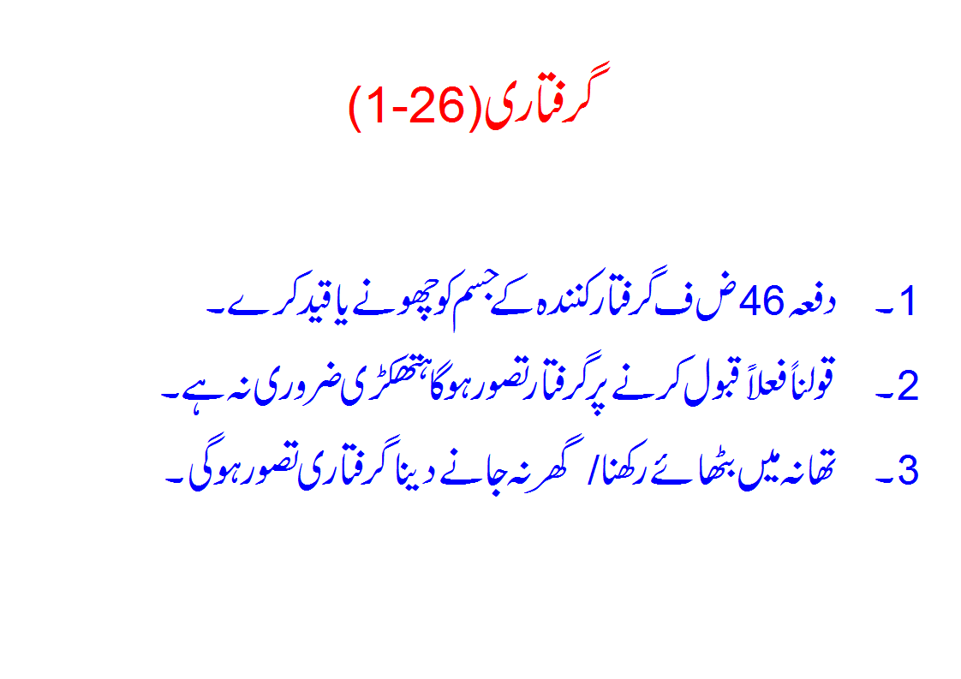

Slide 22
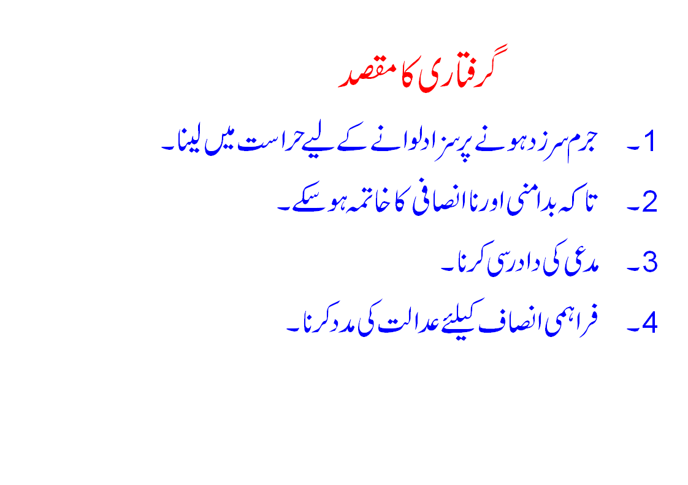

Slide 23
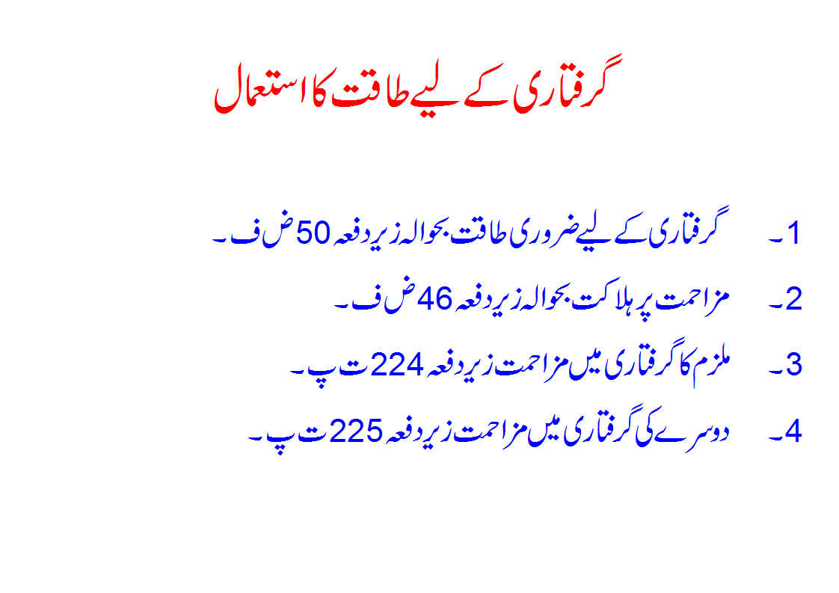

Slide 24
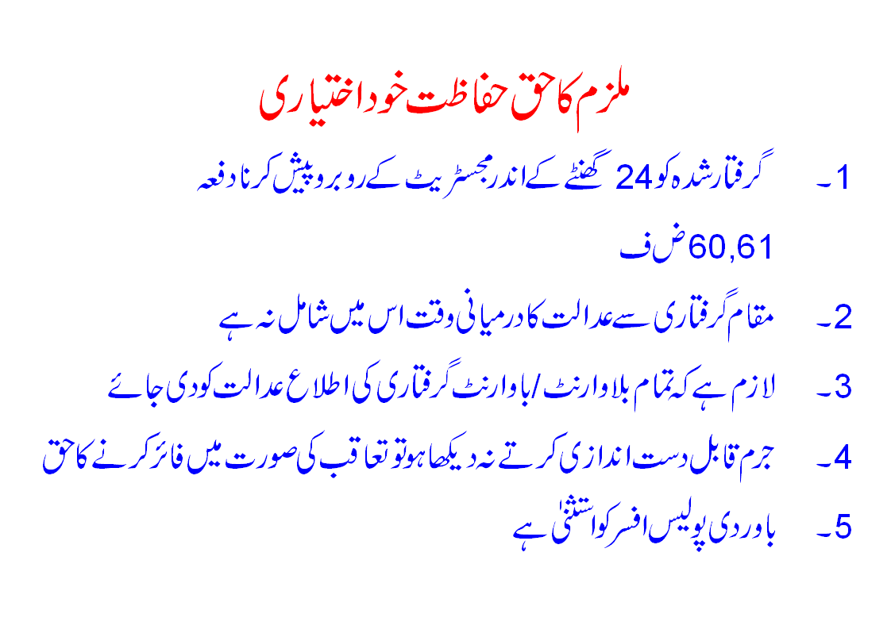

Slide 25
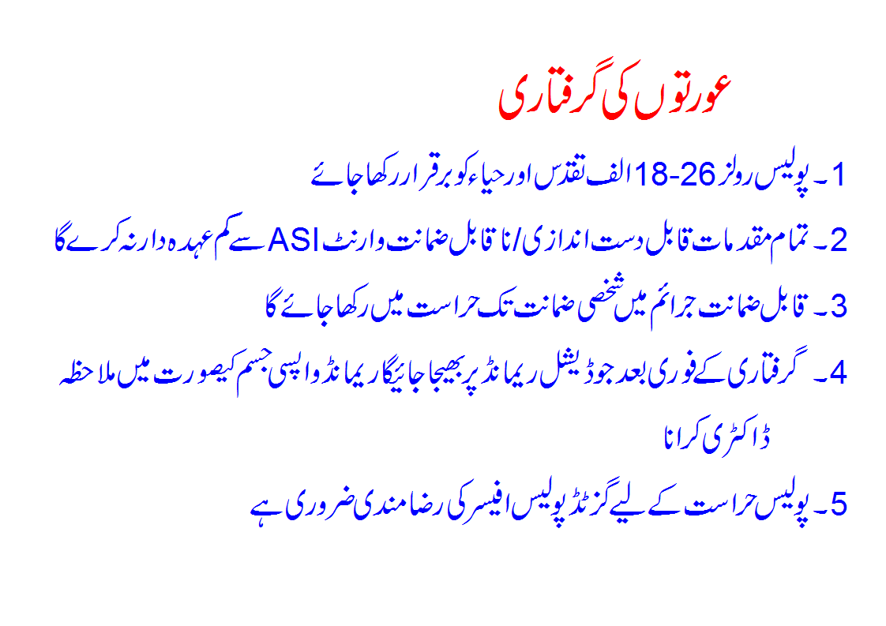

Slide 26
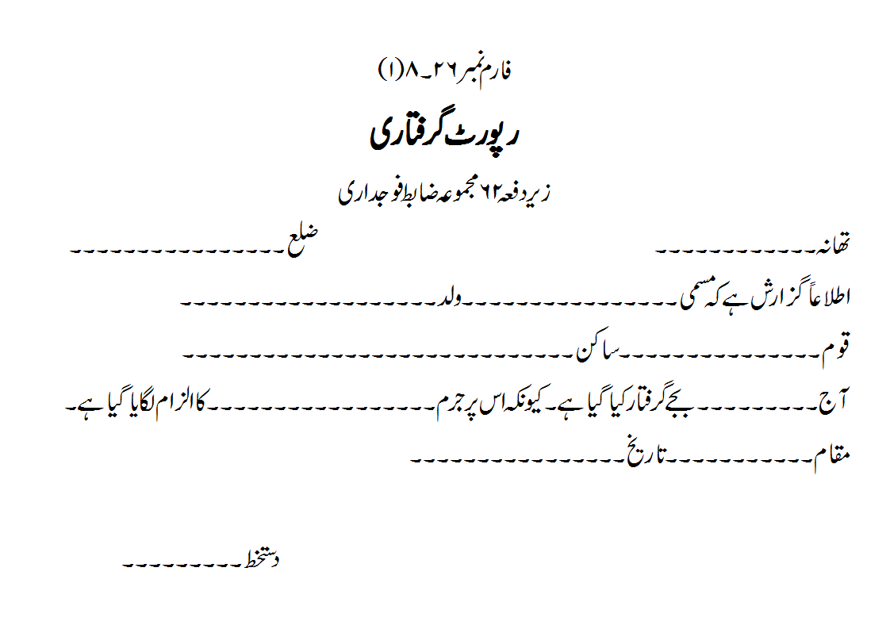

Slide 27
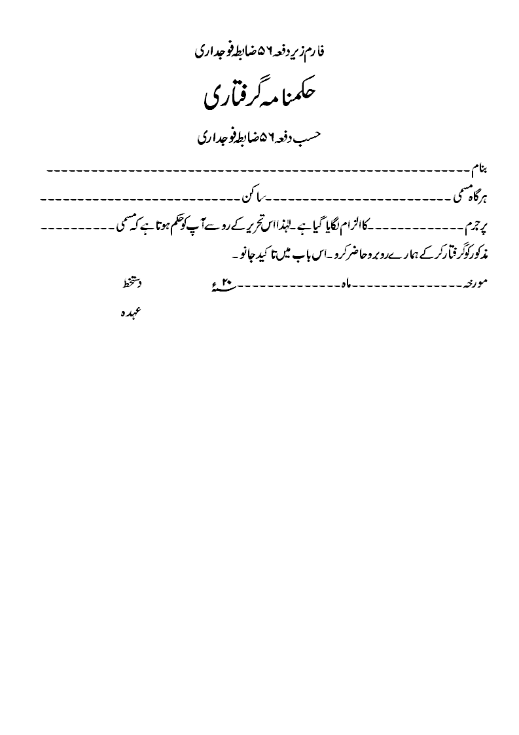

Slide 28
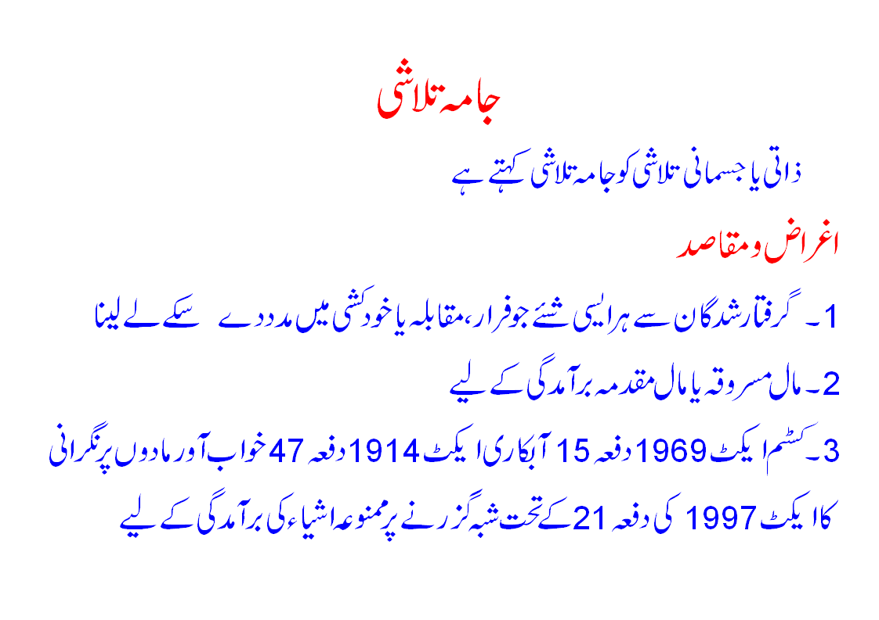

Slide 29
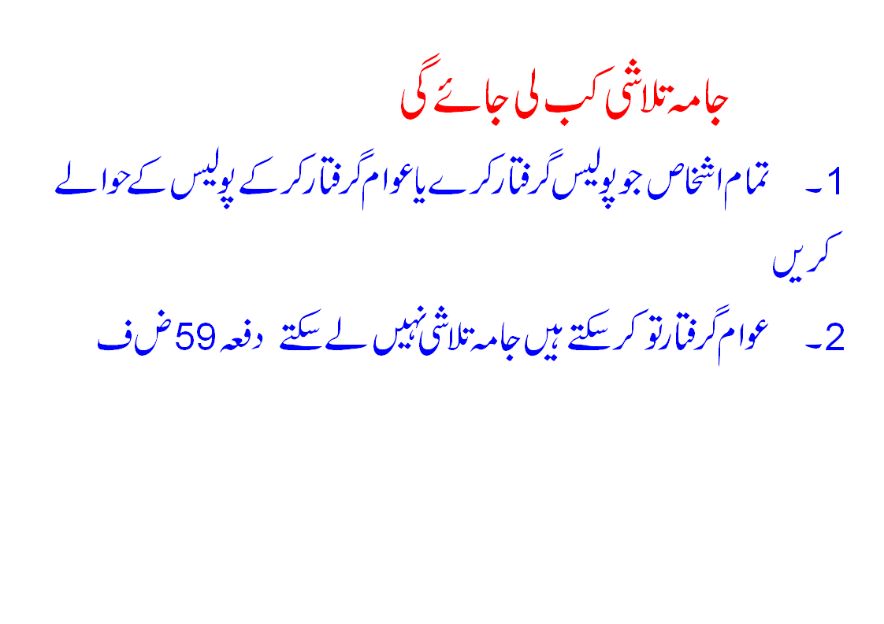

Slide 30
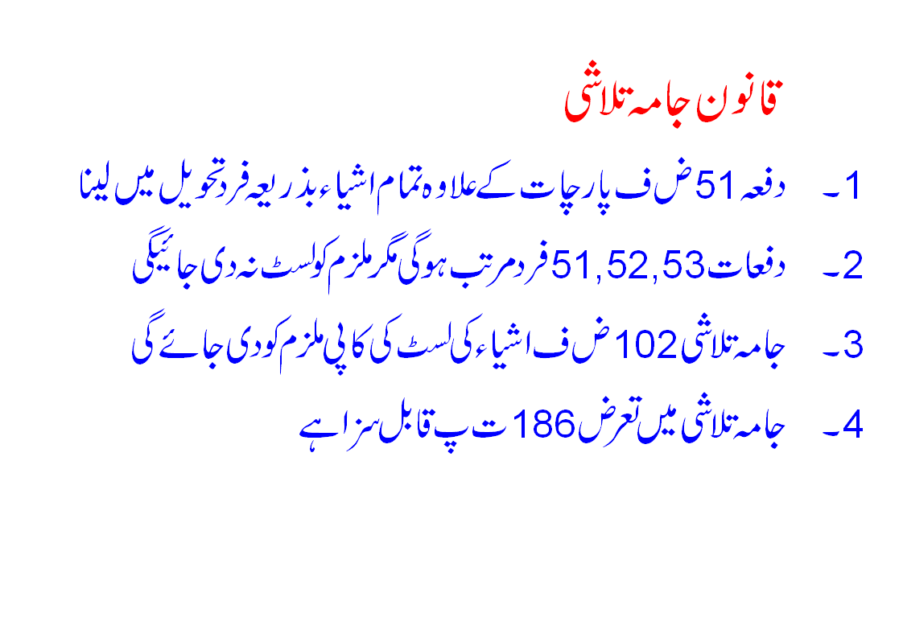

Slide 31
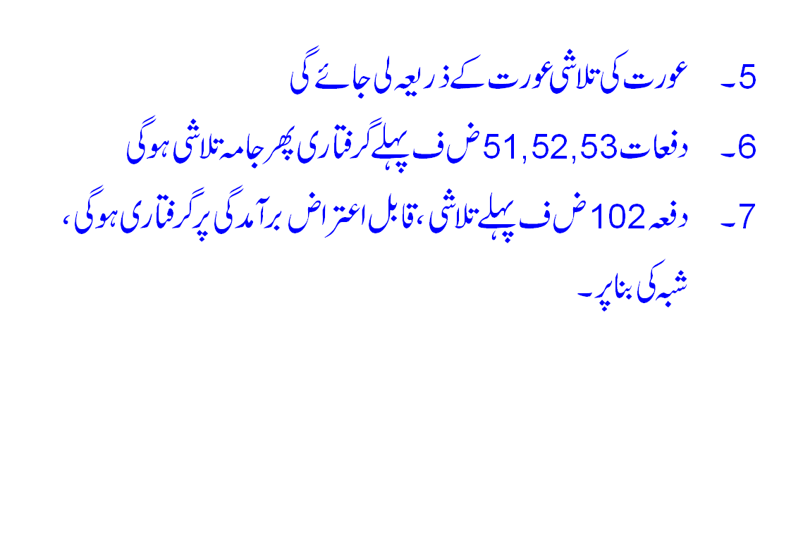

Slide 32
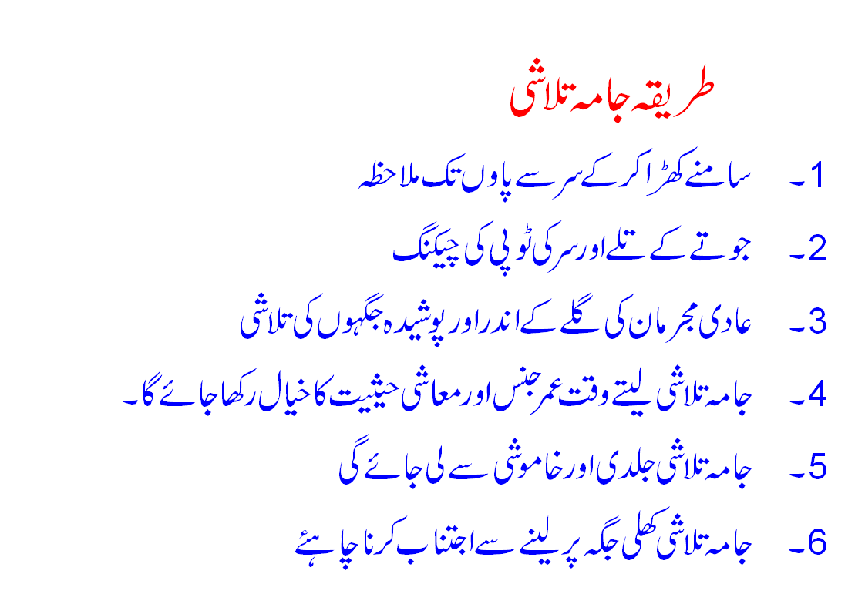

Slide 33
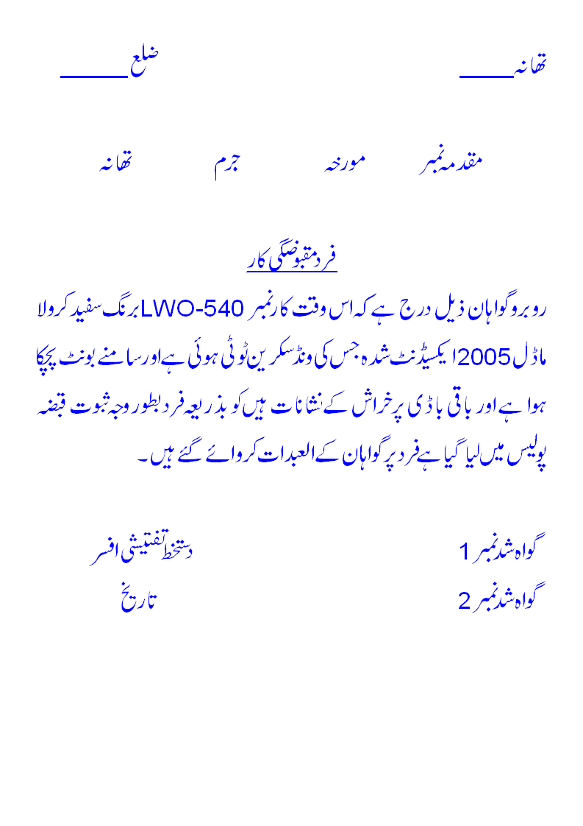

Slide 34
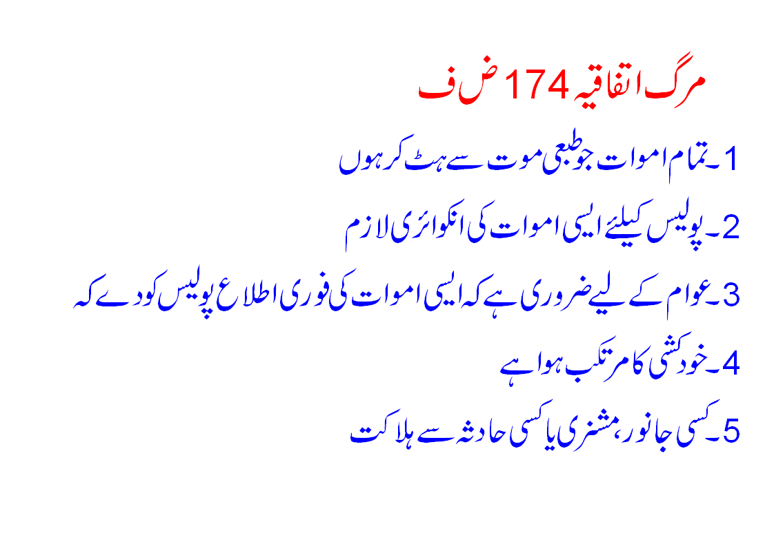

Slide 35
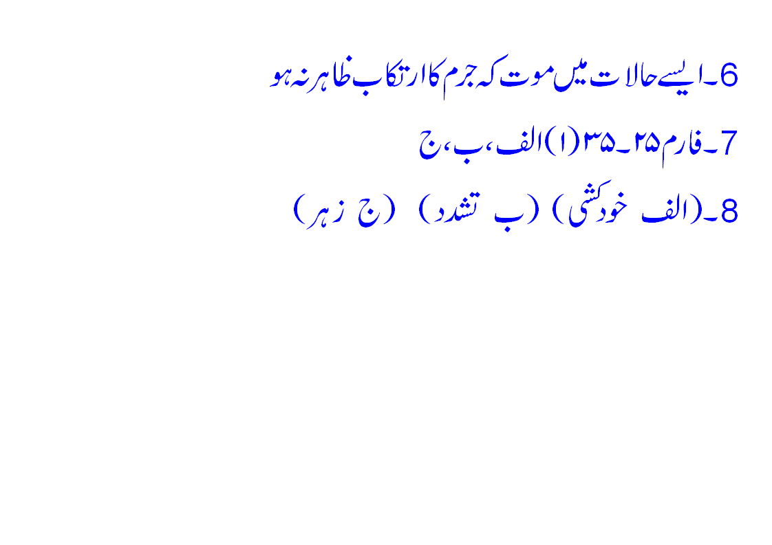

Slide 36
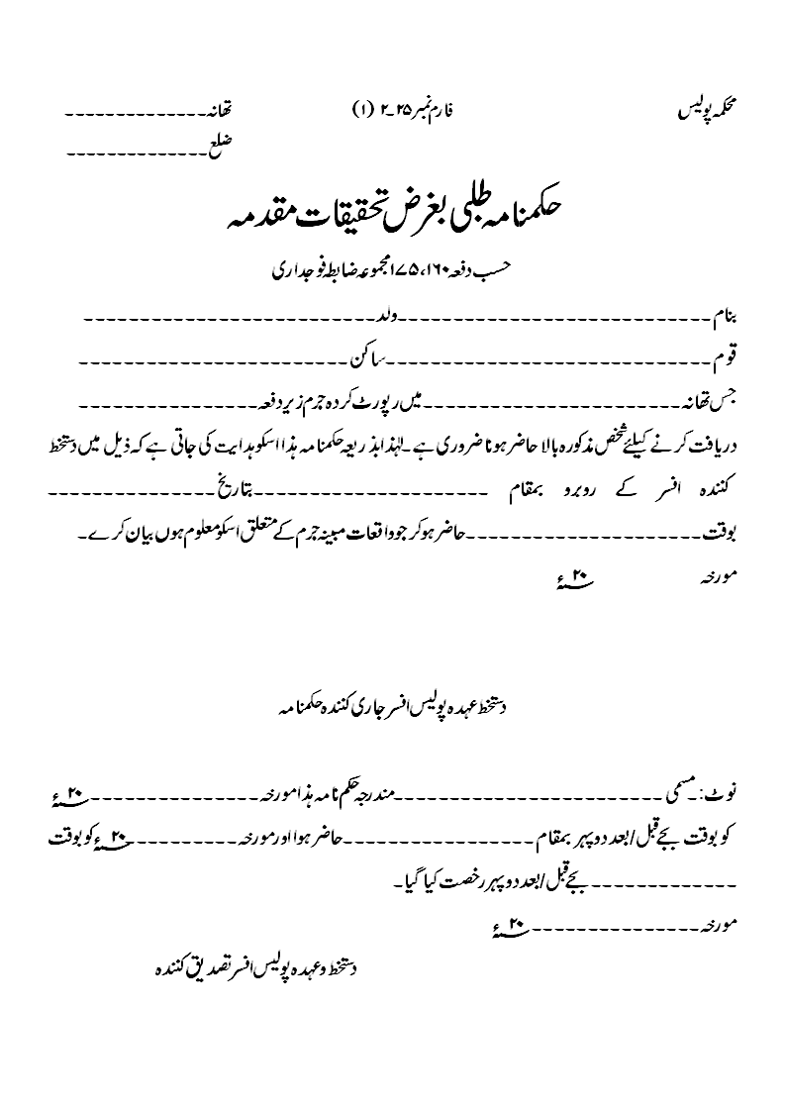

Slide 37
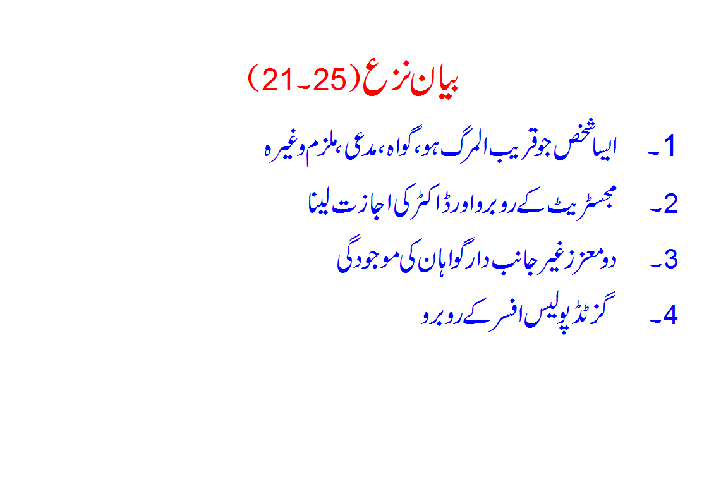

Slide 38
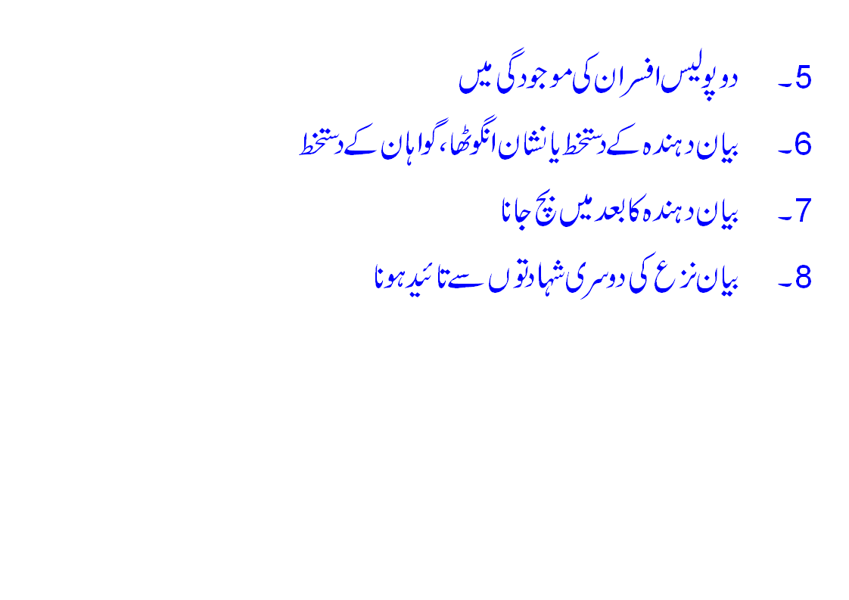

Slide 39
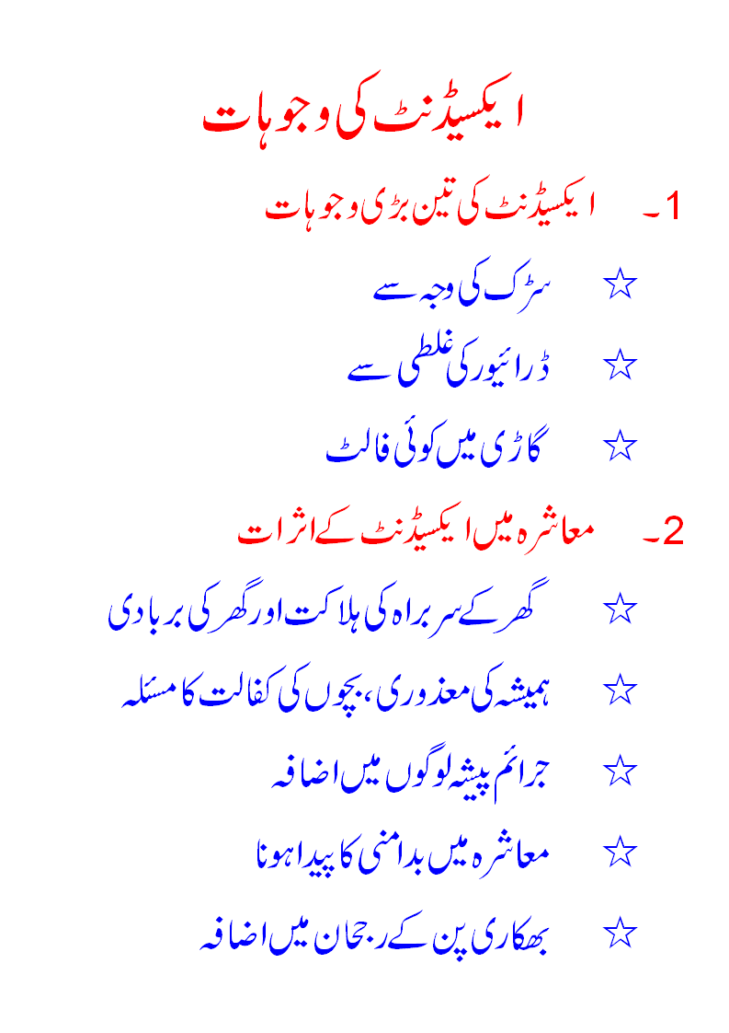

Slide 40
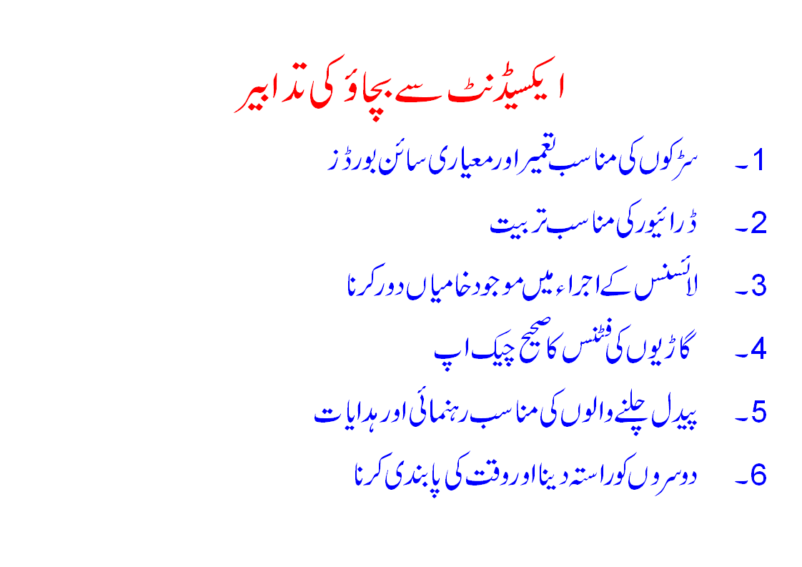

Slide 41
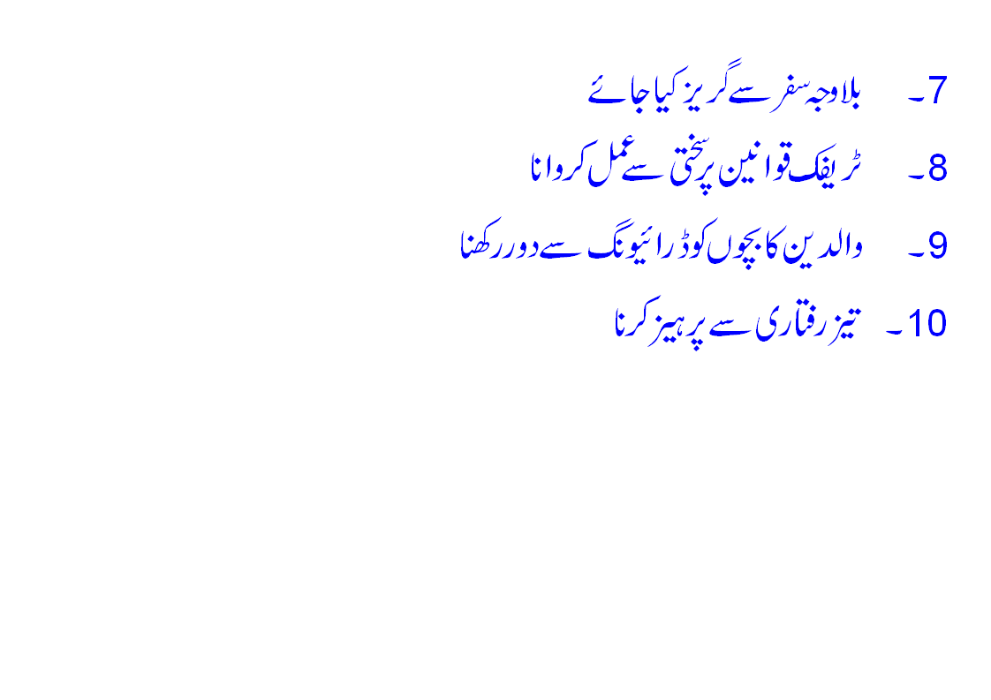

Slide 42

NH&MP Training College

Slide 43
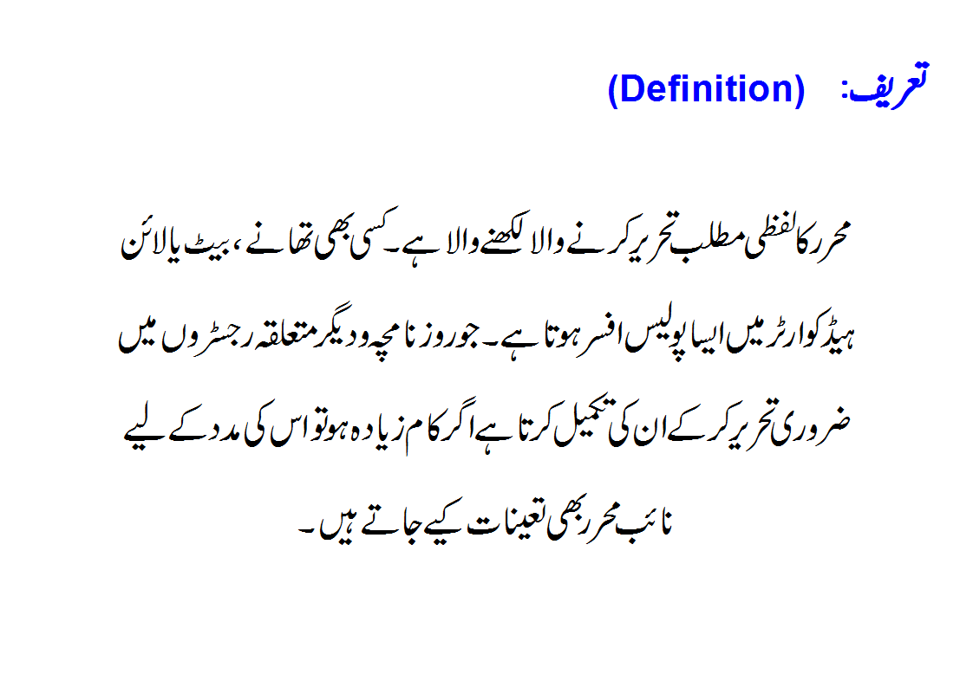
NH&MP Training College

Slide 44
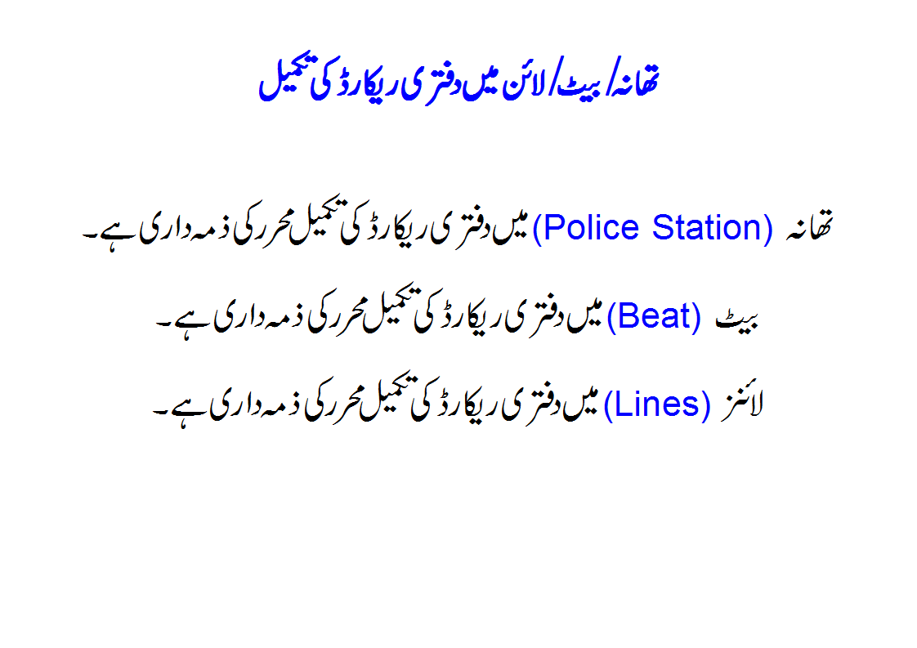
NH&MP Training College

Slide 45
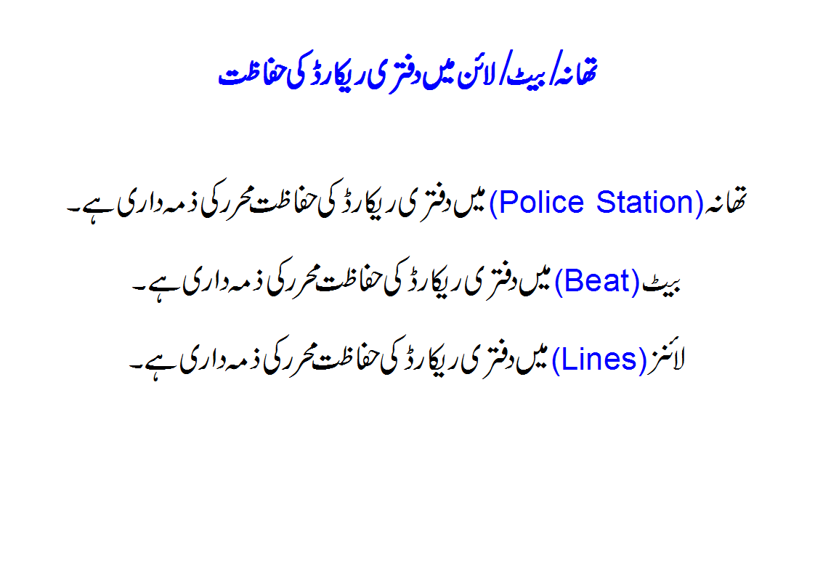
NH&MP Training College

Slide 46
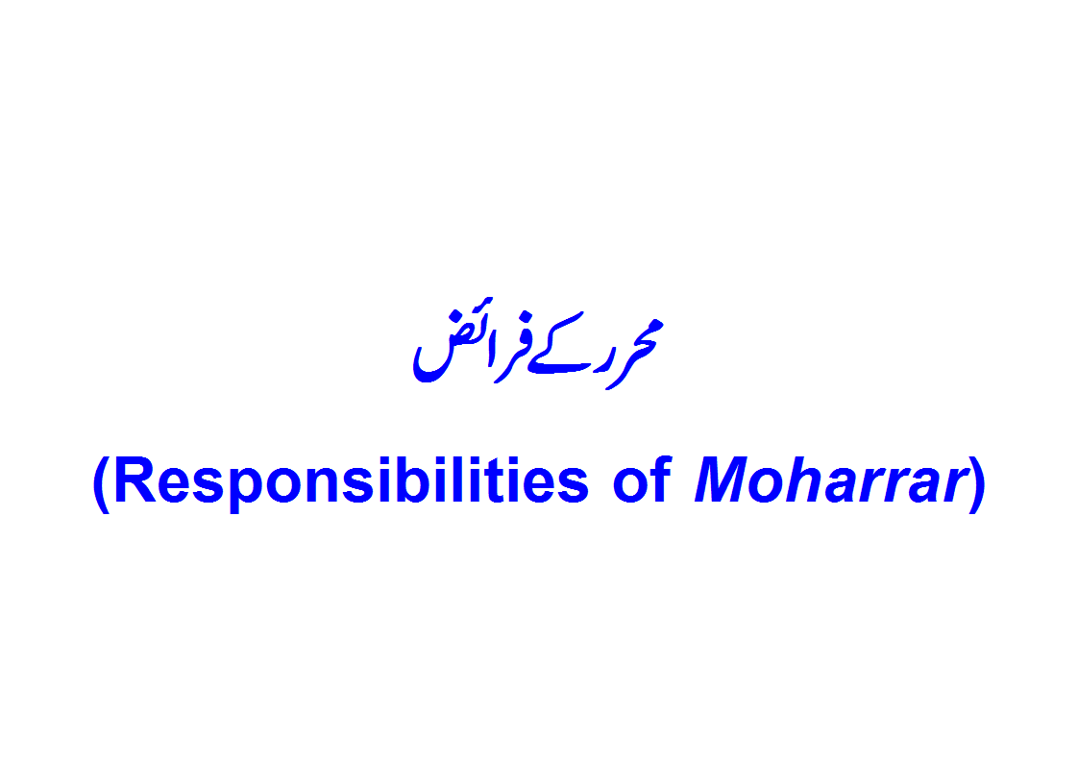
NH&MP Training College

Slide 47
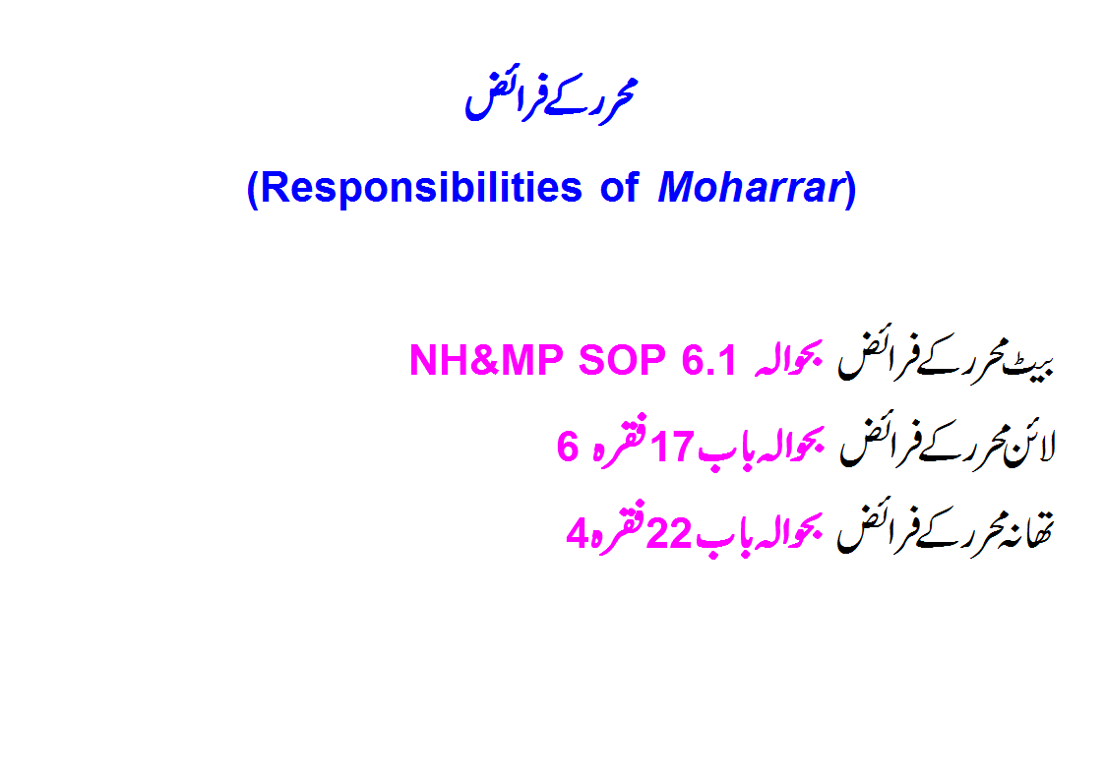
NH&MP Training College

Slide 48
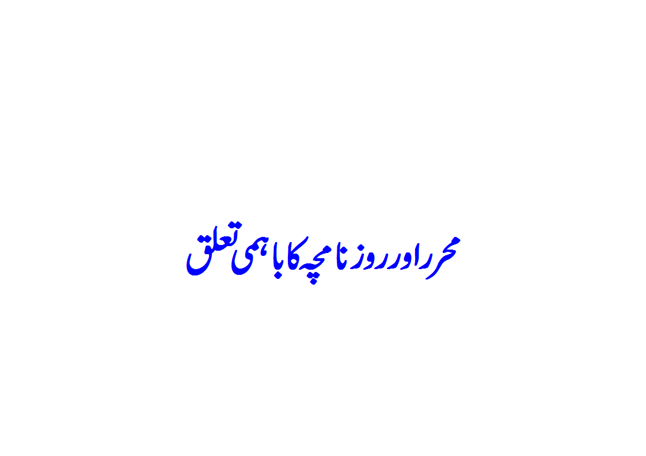
NH&MP Training College

Slide 49
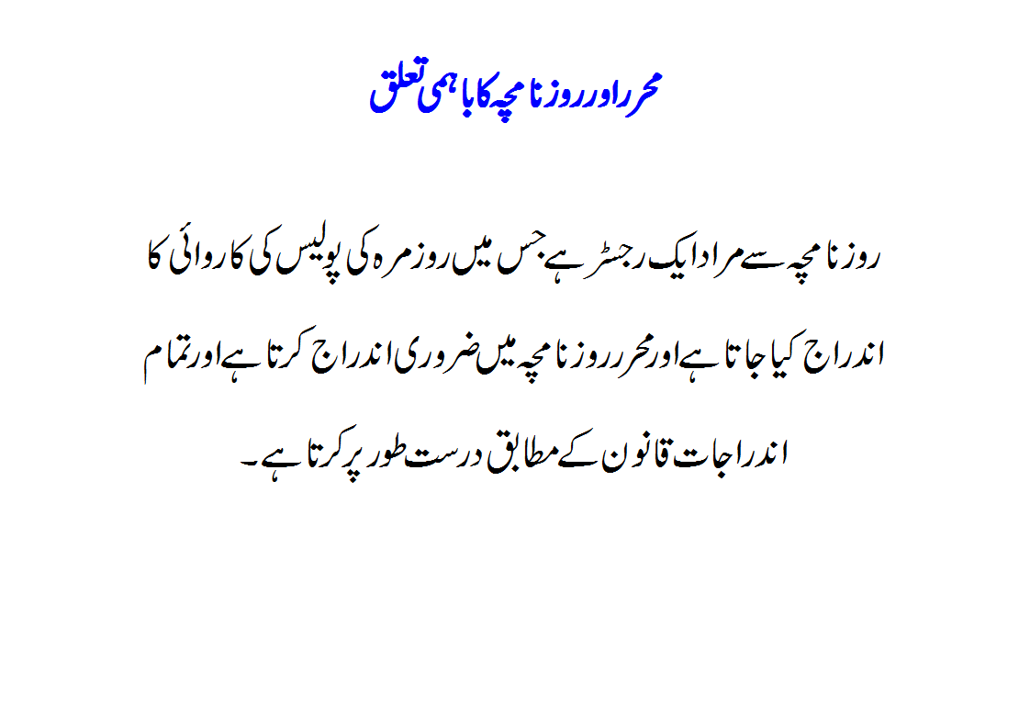
NH&MP Training College

Slide 50
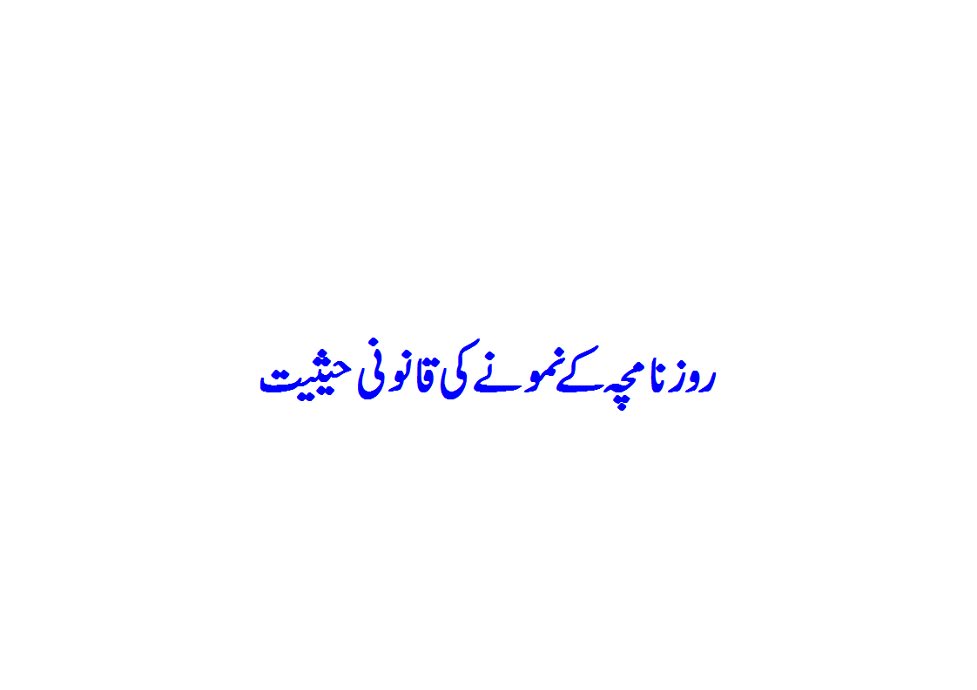
NH&MP Training College

Slide 51
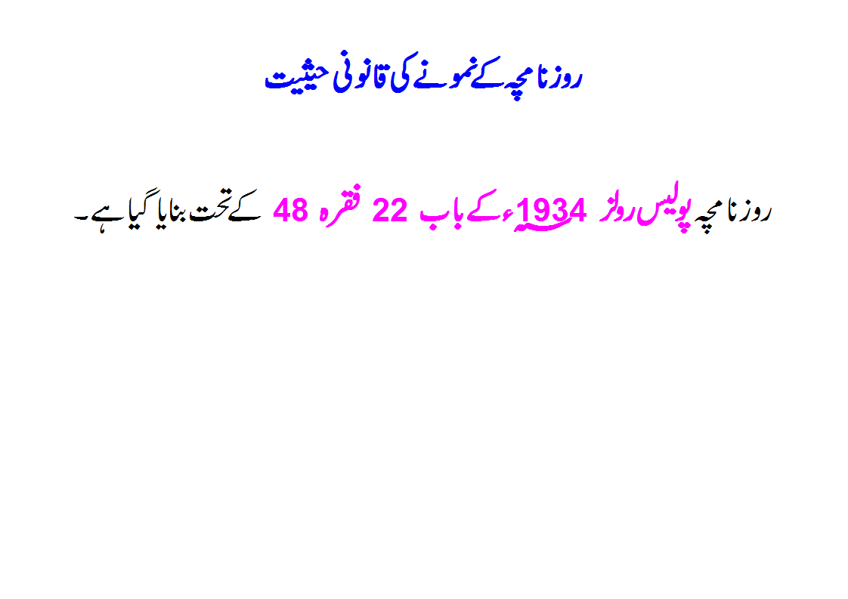
NH&MP Training College

Slide 52

NH&MP Training College

Slide 53

NH&MP Training College

Slide 54

NH&MP Training College

Slide 55

NH&MP Training College

Slide 56

NH&MP Training College

Slide 57

NH&MP Training College

Slide 58

NH&MP Training College

Slide 59

NH&MP Training College

Slide 60

NH&MP Training College

Slide 61

NH&MP Training College

Slide 62

NH&MP Training College

Slide 63

NH&MP Training College

Slide 64

NH&MP Training College

Slide 65

NH&MP Training College

Slide 66

NH&MP Training College

Slide 67

NH&MP Training College

Slide 68

Police Rule,(50-22)
NH&MP Training College

Slide 69

NH&MP Training College

Slide 70

Police Rule(51-22)
NH&MP Training College

Slide 71

NH&MP Training College

Slide 72

NH&MP Training College

Slide 73

Police Rule,( 48-22)
NH&MP Training College

Slide 74

Police Rule,(48-22)
NH&MP Training College

Slide 75

NH&MP Training College

Slide 76

Police Rule,(48-22)
NH&MP Training College

Slide 77

NH&MP Training College

Slide 78

Police Rule,(50-22)
NH&MP Training College

Slide 79

NH&MP Training College

Slide 80

NH&MP Training College

Slide 81

NH&MP Training College

Slide 82

Police Rule,(50-22)
NH&MP Training College

Slide 83

NH&MP Training College

Slide 84

NH&MP Training College

Slide 85

NH&MP Training College

Slide 86

NH&MP Training College

Slide 87

NH&MP Training College

Slide 88

NH&MP Training College

Slide 89


NH&MP Training College

Slide 90

NH&MP Training College

Slide 91

NH&MP Training College

Slide 92

NH&MP Training College

Slide 93

NH&MP Training College

Slide 94

NH&MP Training College

Slide 95

NH&MP Training College

Slide 96

NH&MP Training College

Slide 97

NH&MP Training College

Slide 98


NH&MP Training College

Slide 99

NH&MP Training College

Slide 100

NH&MP Training College

Slide 101


NH&MP Training College

Slide 102

NH&MP Training College

Slide 103

NH&MP Training College

Slide 104


NH&MP Training College

Slide 105

NH&MP Training College

Slide 106

FIRST LANE CLOSE
600 m
ACCIDENT
50 m
300 m
900 m
NH&MP Training College

Slide 107
FIRST & SECOND LANE CLOSE
600 m
ACCIDENT
50 m
300 m
900 m
NH&MP Training College

Slide 108

SECOND &THIRD LANE CLOSE
ACCIDENT
300 m
600 m
900 m
NH&MP Training College

Slide 109
THIRD LANE CLOSE
50 m
ACCIDENT
600 m
300 m
900 m
NH&MP Training College

Slide 110
THANKS
NH&MP Training College

Slide 111

NH&MP Training College

Slide 112

NH&MP Training College

Slide 113

NH&MP Training College

Slide 114

NH&MP Training College

Slide 115

NH&MP Training College

Slide 116

NH&MP Training College

Slide 117

NH&MP Training College

Slide 118

NH&MP Training College

Slide 119

NH&MP Training College

Slide 120

NH&MP Training College

Slide 121

NH&MP Training College

Slide 122

NH&MP Training College

Slide 123

NH&MP Training College

Slide 124

NH&MP Training College

Slide 125

NH&MP Training College

Slide 126

NH&MP Training College

Slide 127

NH&MP Training College

Slide 128

NH&MP Training College

Slide 129

NH&MP Training College

Slide 130

NH&MP Training College

Slide 131

NH&MP Training College

Slide 132

NH&MP Training College

Slide 133

NH&MP Training College

Slide 134

NH&MP Training College

Slide 135

NH&MP Training College

Slide 136

NH&MP Training College

Slide 137

NH&MP Training College

Slide 138

NH&MP Training College

Slide 139

NH&MP Training College

Slide 140

NH&MP Training College

Slide 141

NH&MP Training College

Slide 142

NH&MP Training College

Slide 143

NH&MP Training College

Slide 144

NH&MP Training College

Slide 145

NH&MP Training College

Slide 146

NH&MP Training College

Slide 147
THANKS
NH&MP Training College

